Slide 1

Go, change the world
RV College of
Engineering
LENET
Sushanth S Rao
1RV23SCS16

Slide 2
Lenet
(Unit 5)

Slide 3
INDEX
Introduction
Features
Architecture
Details of 6 Layers
Lenet Implementation
Conclusion

Slide 4
Introduction
Lenet is a convolution neural network (CNN) architecture
Proposed by Yann LeCunn and et al in 1980
It is one of the earliest and most influential CNN developed primarily for handwritten digit recognition
It revolutionized the field of
Computer Vision
Pattern Recognition

Slide 5
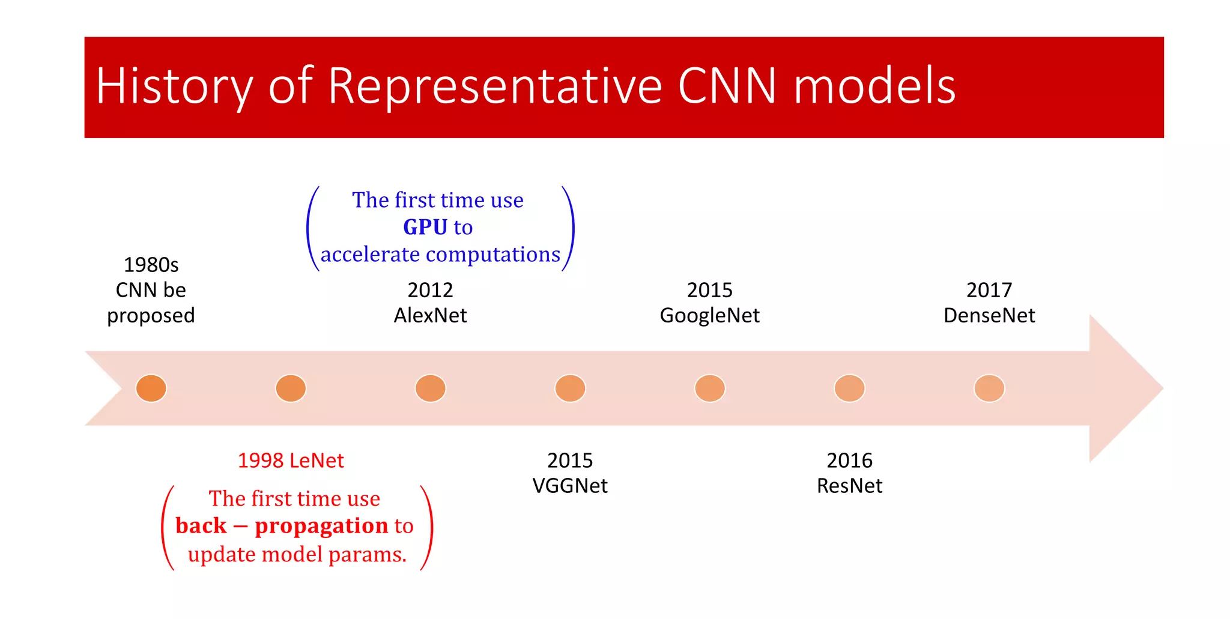
Lenet – The basis for Deep Learning Architecture

Slide 6
Key Features
Data: Trained on the MNIST dataset (handwritten digits). (Modified National Institute of Standards and Technology database)
Loss Function: Cross-entropy loss is used for classification tasks.
Optimizer: Stochastic Gradient Descent (SGD) and variants.
Backpropagation: Used to update the weights in the network.

Slide 7
ARCHITECTURE: LAYERs
Convolutional Layers [3]
Pooling Layers (Subsampling) [2]
Fully Connected Layers [1]

Slide 8
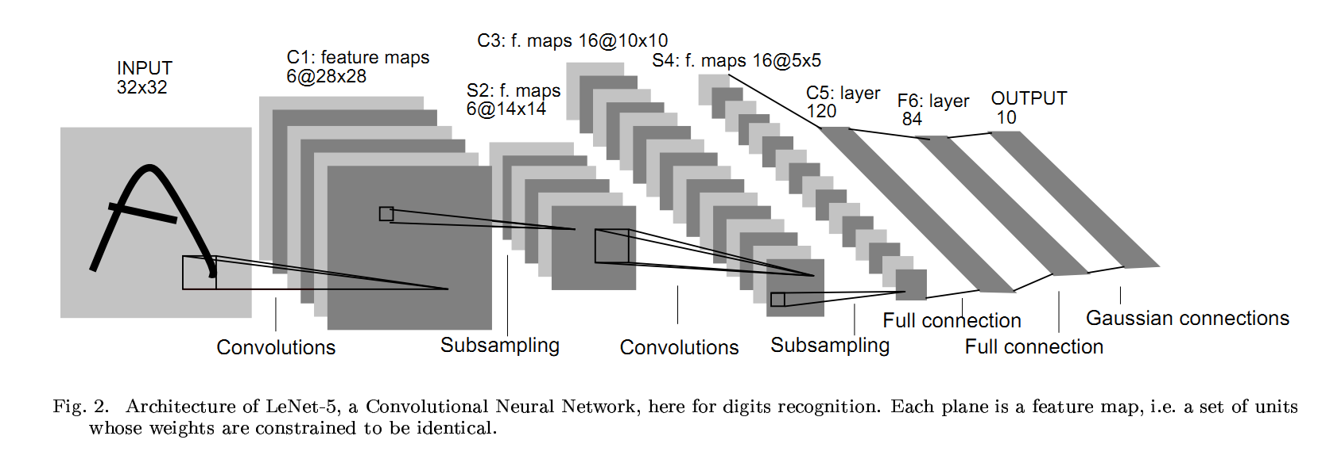
architecture
Lenet

Slide 9
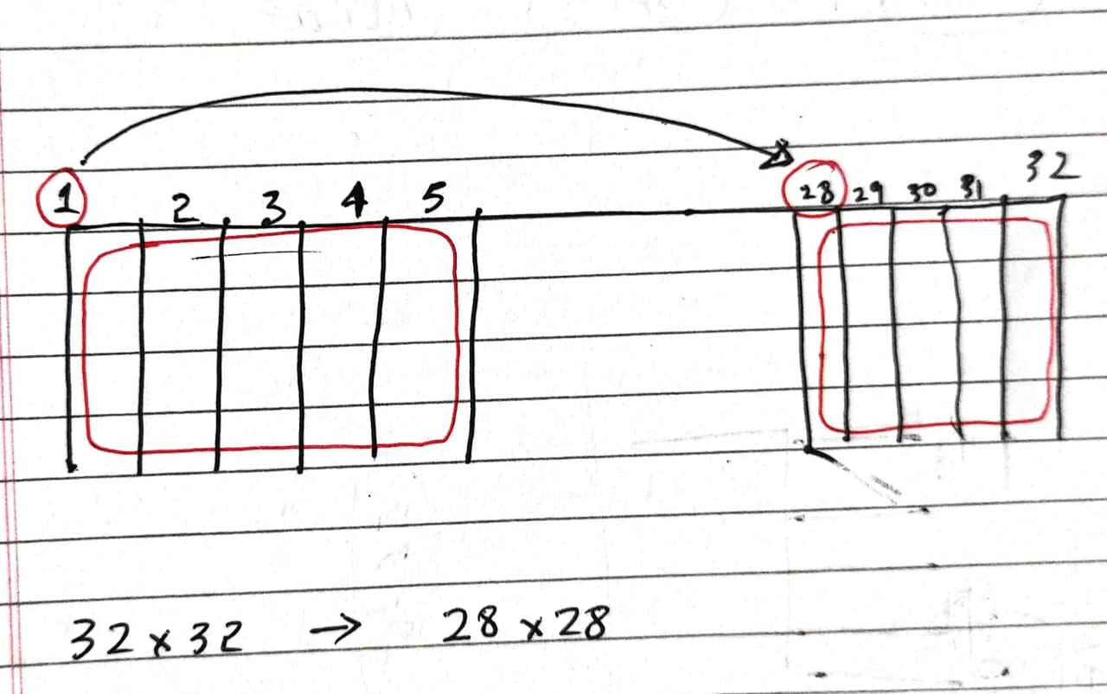
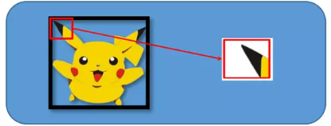
Convolutional Layers:
Extract features by applying filters to the input image.

Slide 10
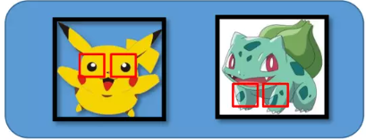
Convolutional Layers:
Each filter detects specific patterns like edges or textures.
Shared weights (Parameter Sharing)
Uses the same set of weights (filter) across different positions of the input image.
Same filter can detect the feature (eyes) across different spatial locations.

Slide 11
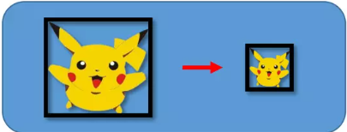
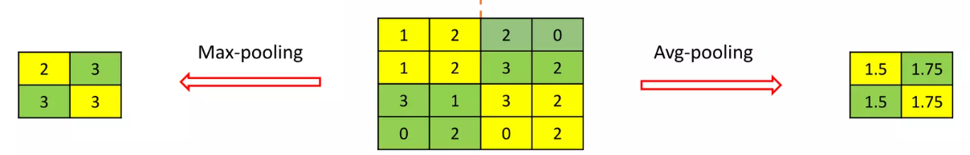
Pooling Layers (Subsampling):
Reduces the spatial dimensions (width and height) of the feature maps while retaining the most important information.
It will not change the object, rather just decreases the memory consumption and computational load

Slide 12
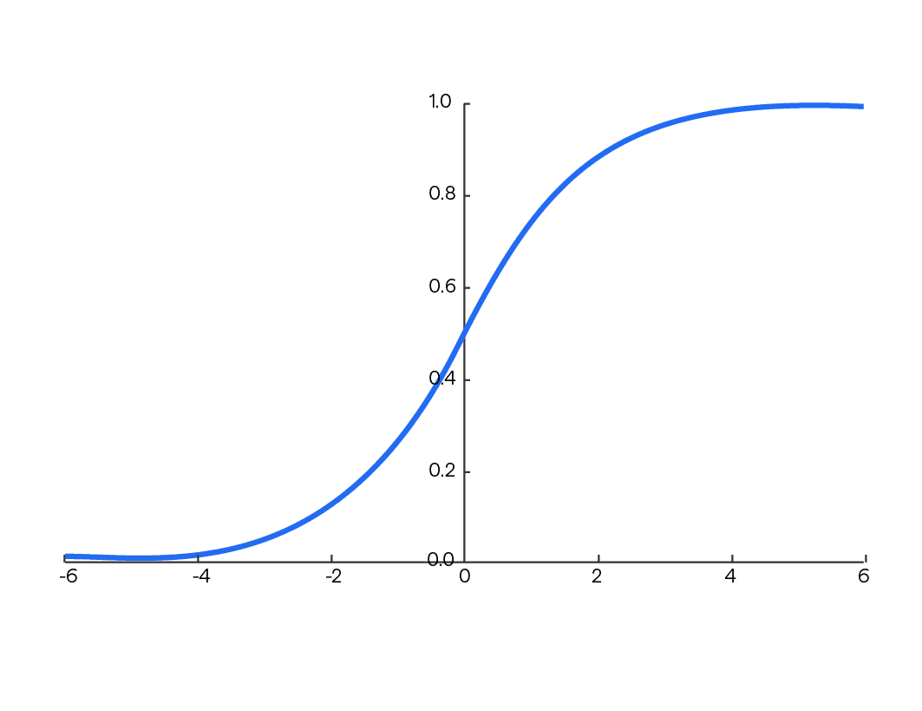
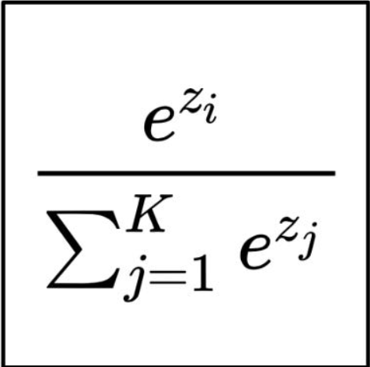
Fully Connected Layers:
Combine features learned by convolutional and pooling layers to classify the input image.
Applies non linear activation function: softmax

Slide 13
Layers
Input Layer: Accepts 32x32 pixel images
C1 - Convolutional Layer: Results in feature map of size 28x28
S2 - Subsampling Layer: 14x14
C3 - Convolutional Layer: 10x10
S4 - Subsampling Layer: 5x5
C5 - Convolutional Layer: 1x1
Output Layer: 10 units for classification (Digits 0-9)
LAYERS | Filters | Filter Size | Resulting Feature Maps
C1 - Convolutional Layer | 6 | 5x5 | 28x28
S2 - Subsampling Layer | 6 | 2x2 pooling | 14x14
C3 - Convolutional Layer | 16 | 5x5 | 10x10
S4 - Subsampling Layer | 16 | 2x2 pooling | 5x5
C5 - Convolutional Layer | 120 | 5x5 | 1x1
F6 - Fully Connected Layer |  |  | 84 units

Slide 14
architecture
Lenet

Slide 15
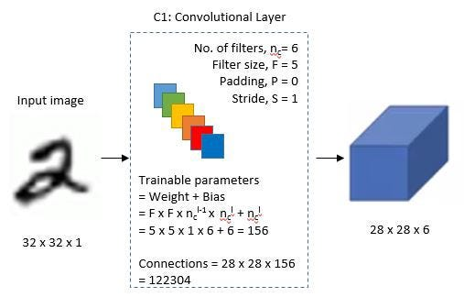
C1 - Convolutional Layer

Slide 16
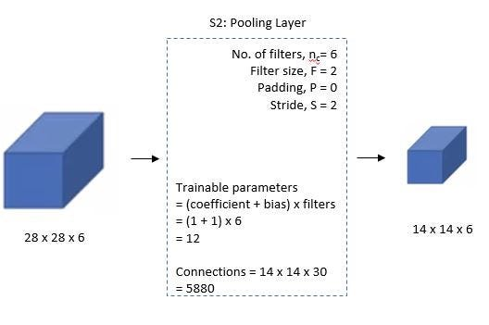
S2 – Pooling Layer

Slide 17
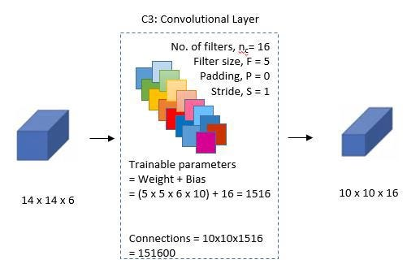
C3 – Convolution Layer

Slide 18
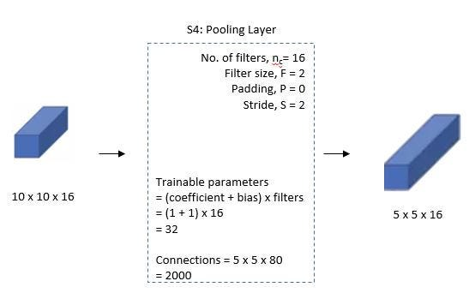
S4 - Pooling Layer

Slide 19
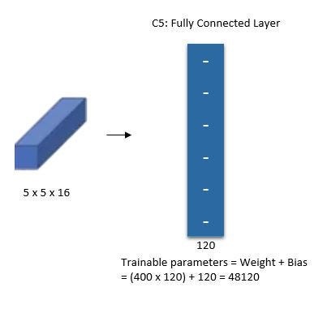
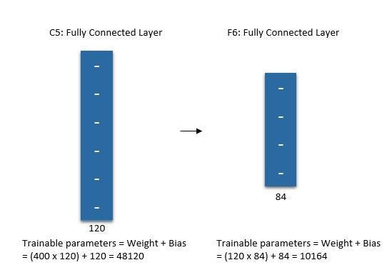
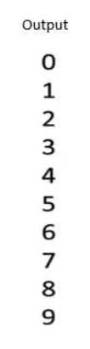


S4 - Pooling Layer
C5 – Convolution Layer
F6 - Fully Connected

Slide 20
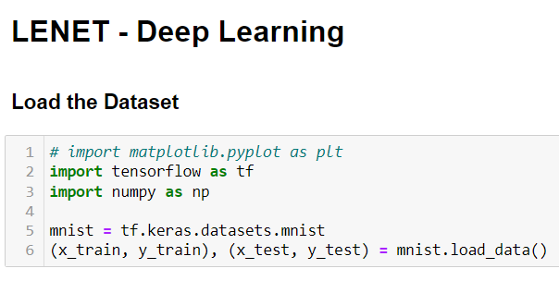
LENET - Implementation

Slide 21
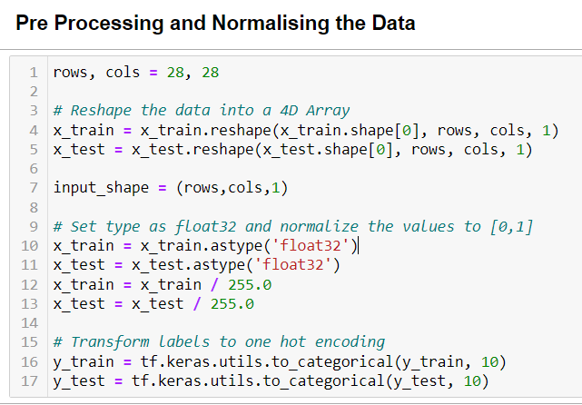
LENET - Implementation

Slide 22
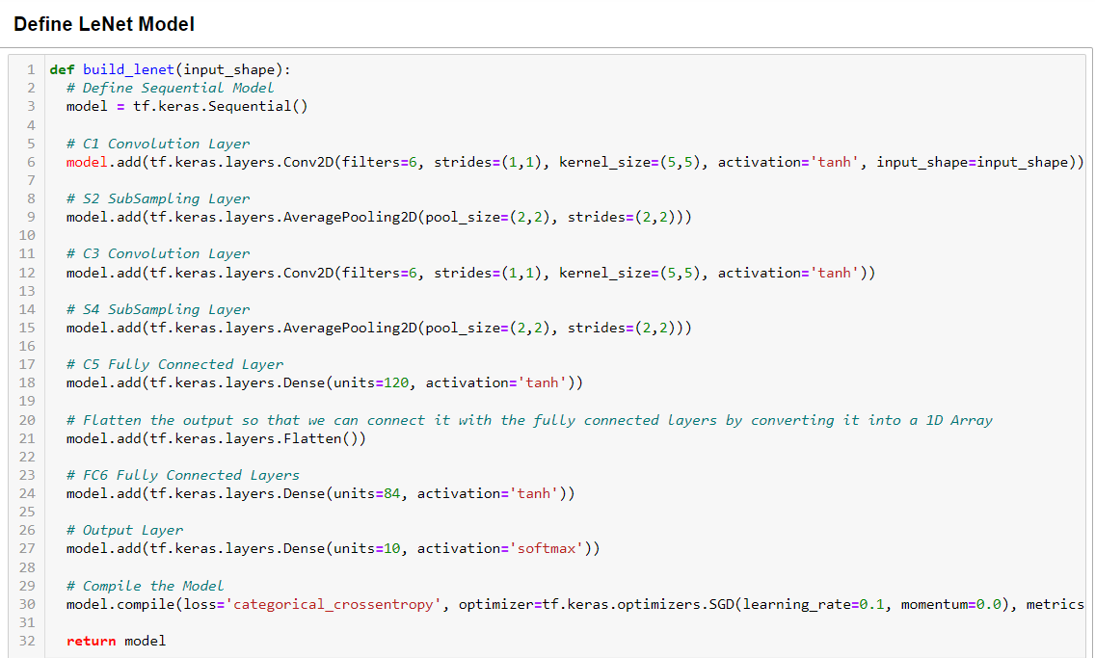
LENET - Implementation

Slide 23
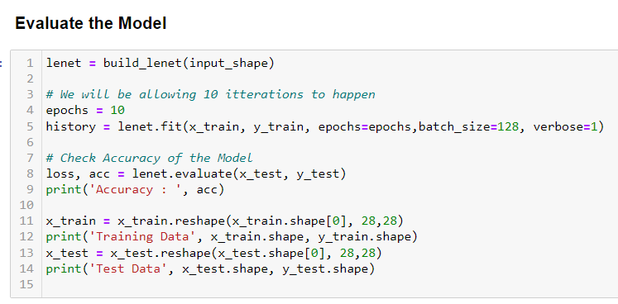
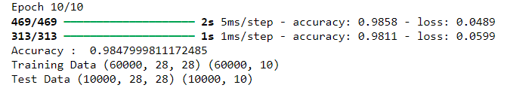
LENET - Implementation

Slide 24
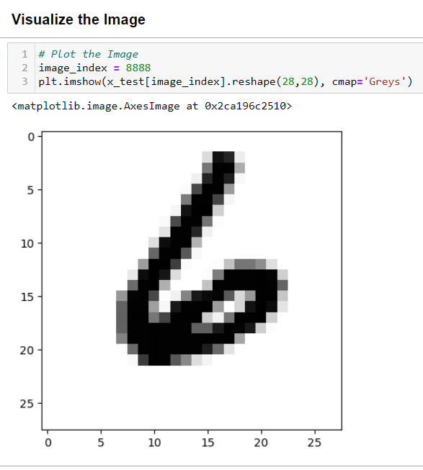
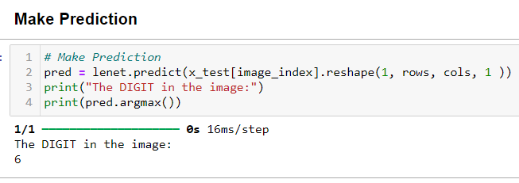

Slide 25
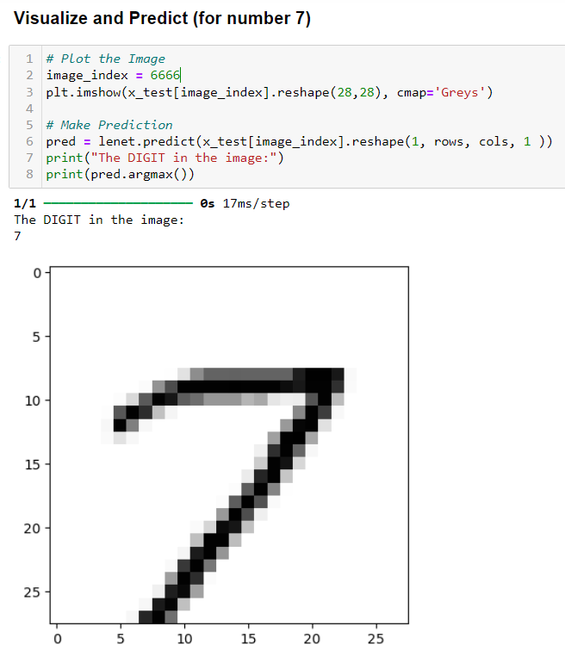

Slide 26
Significance
Innovation: One of the first CNNs, demonstrating the power of deep learning for image recognition.
Foundation: Provided the foundation for modern deep learning architectures like AlexNet, VGG, and ResNet
Accuracy: High accuracy on the MNIST dataset, achieving above 99%
LeNet's simplicity and effectiveness paved the way for modern deep learning research and applications

Slide 27
THANK YOU

